Slide 1
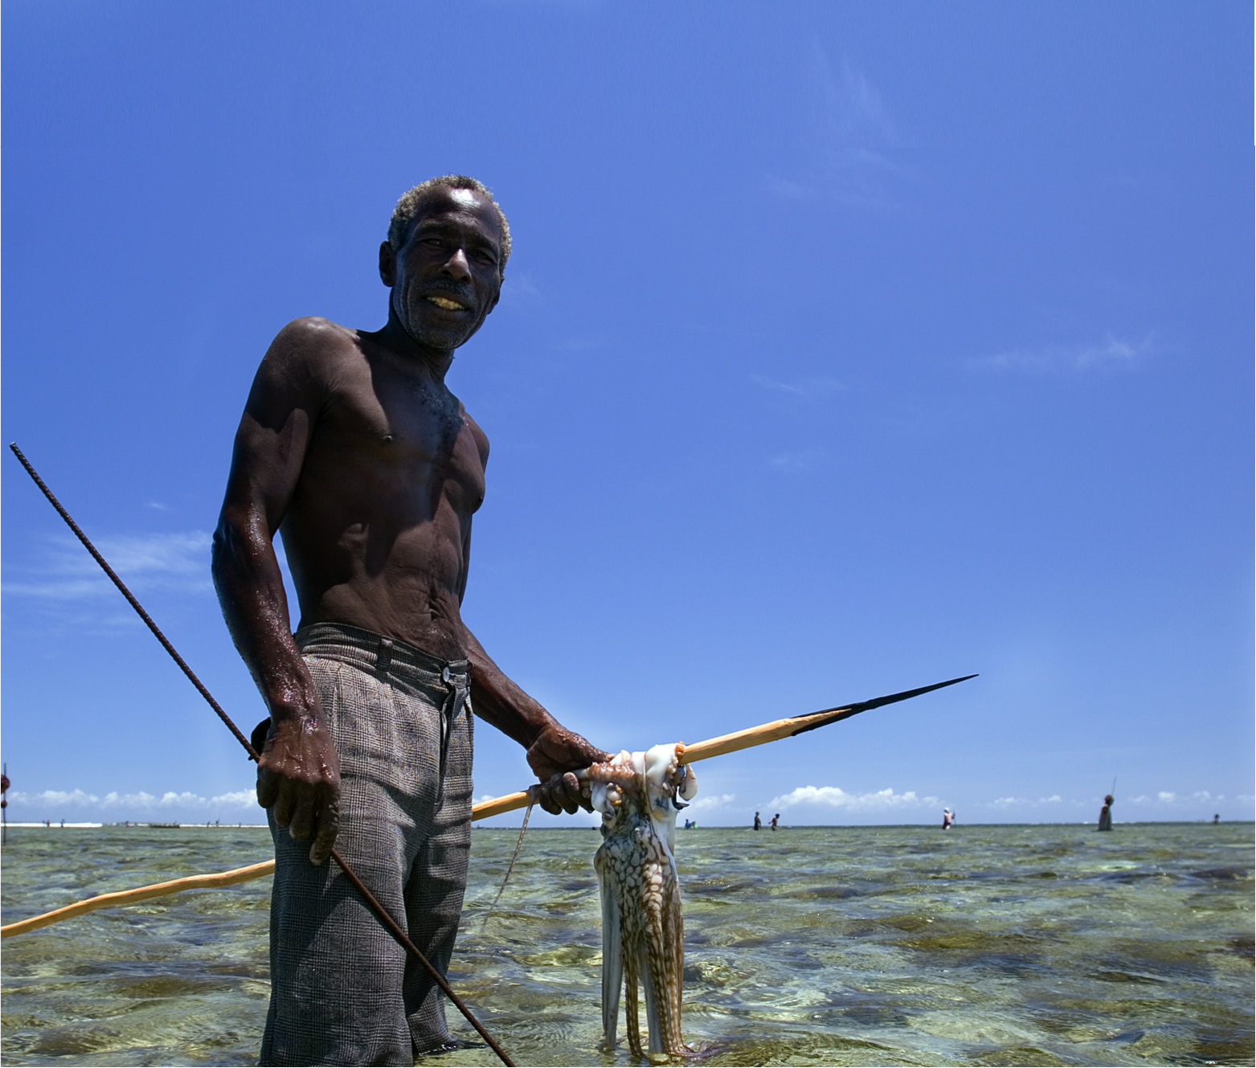
Temporary Octopus Fishery Closures
SW Madagascar
Modeling the Economic Benefits of Temporary Octopus
Fisheries Closures
Notes:
Today I’m going to talk with you about the economic benefits derived from temporary octopus fisheries closures

Slide 2





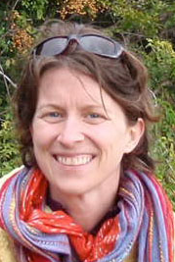




Temporary Octopus Fishery Closures
SW Madagascar
Modeling the Economic Benefits of Temporary Octopus
Fisheries Closures
Tom A Oliver
HIMB – U. Hawai’i
Alasdair Harris
Blue Ventures
Kirsten LL Oleson
NREM – U. Hawai’i
Ratsimbazafy H, Benbow S, Raberinary D, Humber F
Notes:
A lot of researchers have been involved in examining a locally managed marine area called Velondriake, a co-management arrangement between communities and the UK-based NGO, Blue Ventures Conservation

Slide 3
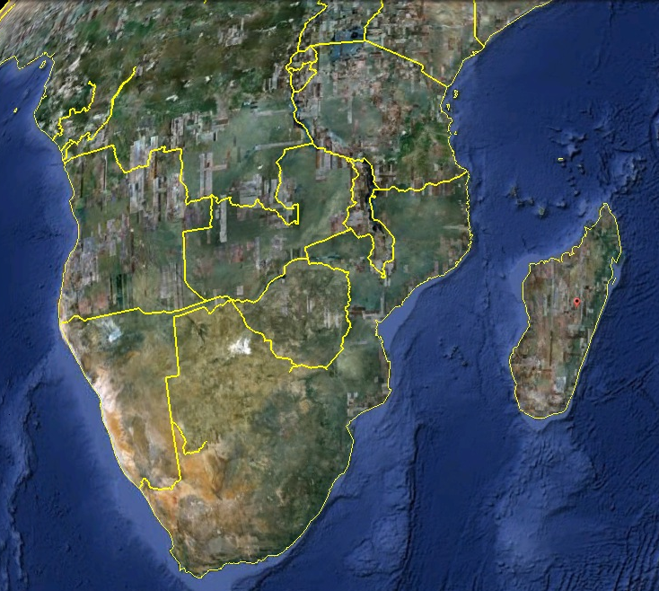
Notes:
Velondriake lies in the SW of Madagascar, the island here off the coast of Mozambique

Slide 4
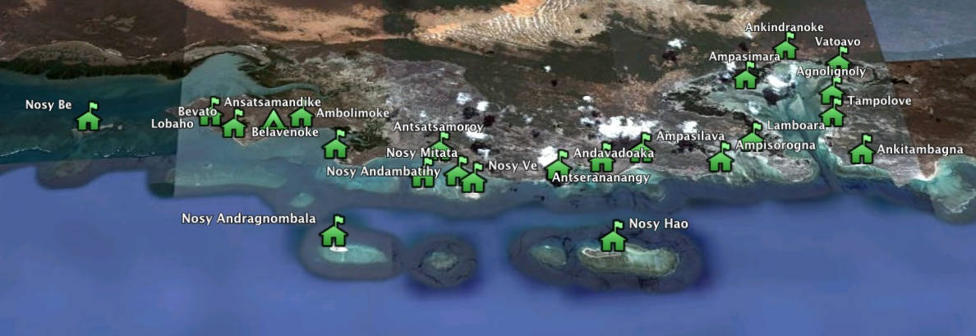
  91% of adults are fisher or gleaners
  Average per capita income – $1.86 (PPP)/day
Notes:
The 25 villages in the LMMA span 50 km of coast. People are very resource dependent and poor.

Slide 5
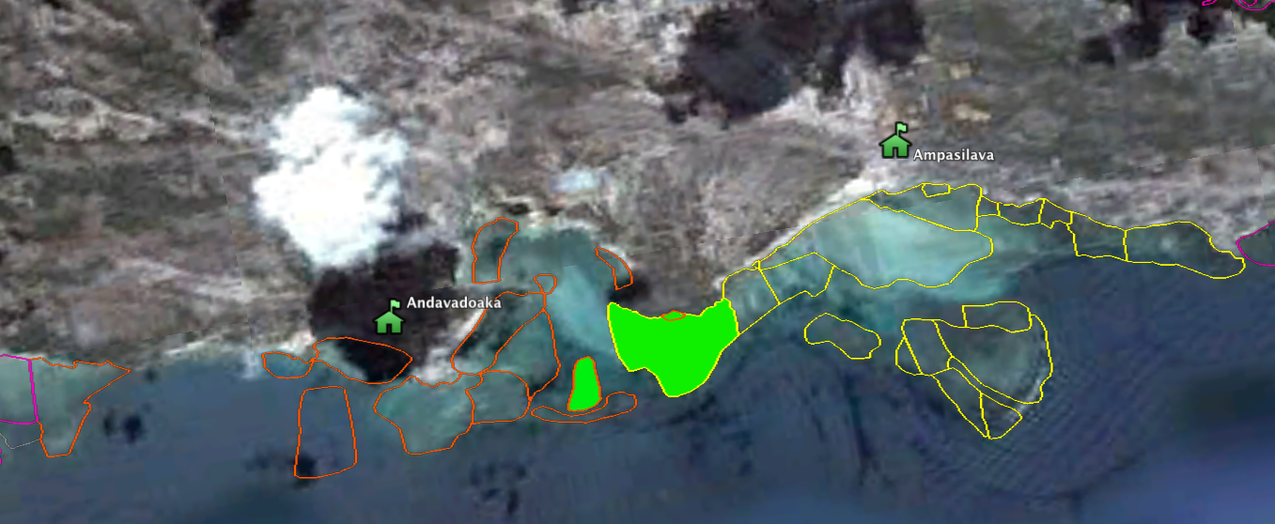
Two Villages’ Octopus Fishing Grounds
Co-Sponsored Site Closed For Three Months
Notes:
The innovative fishery closure regime involves closing a small portion (~20%) of a village’s octopus fishing area for short period (usually 2-3 months). This slide shows you one example. The red polygons are one village’s octopus fishing areas, the yellow another’s. These villages cooperated to close a mutual area lying between the two.

Slide 6
Do village octopus closures increase catch?
Do the costs of the closures pay-off economically?
Notes:
Our research asks 2 questions. [read]

Slide 7
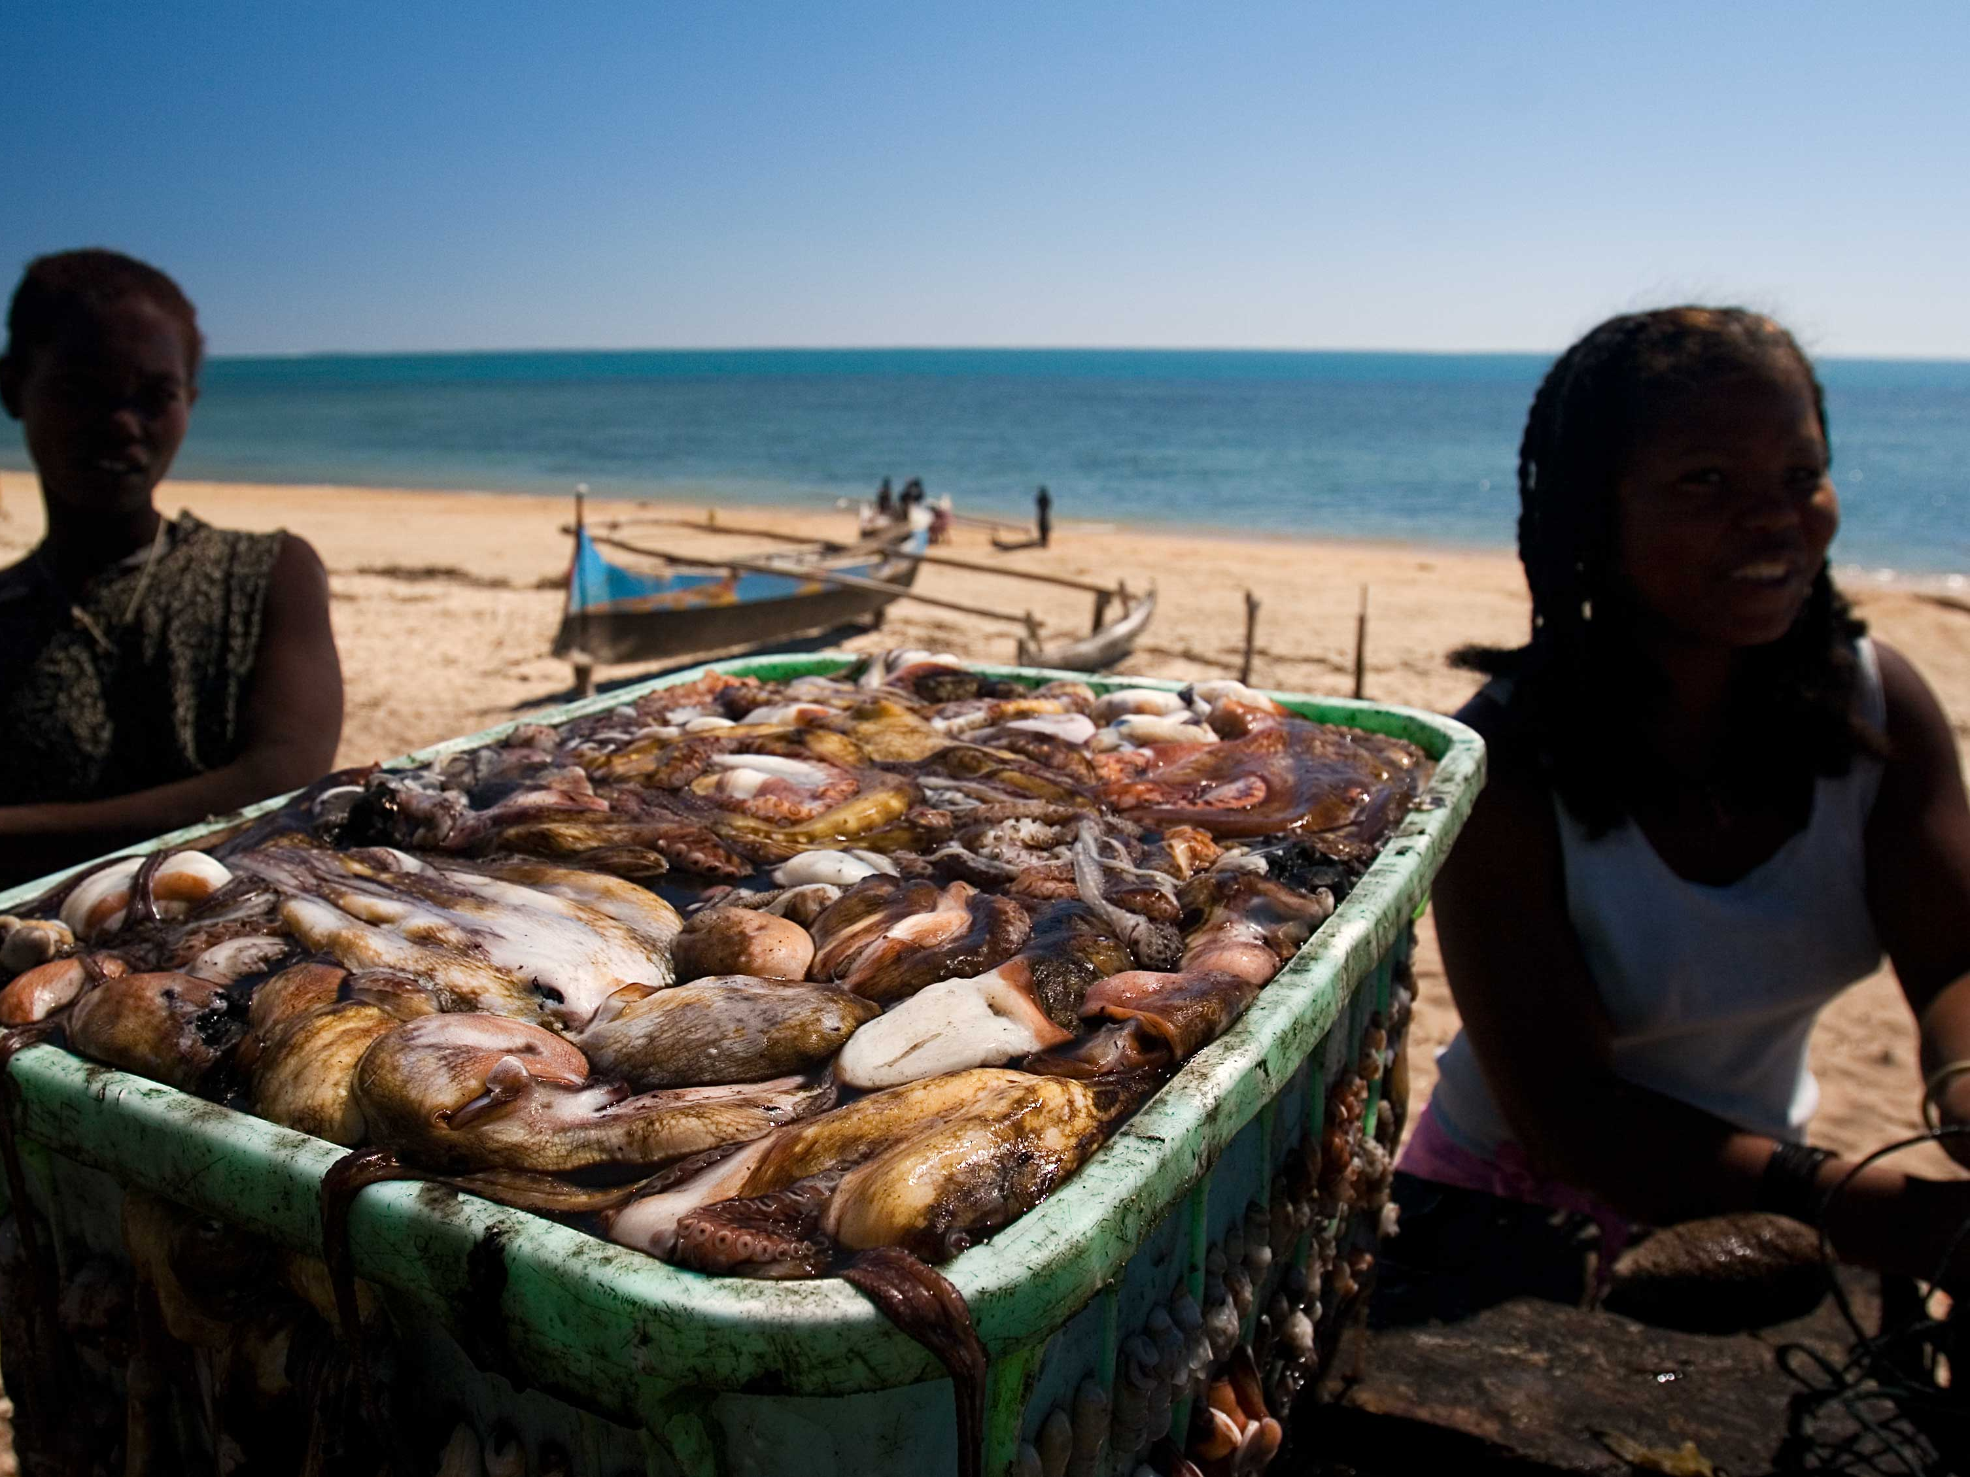
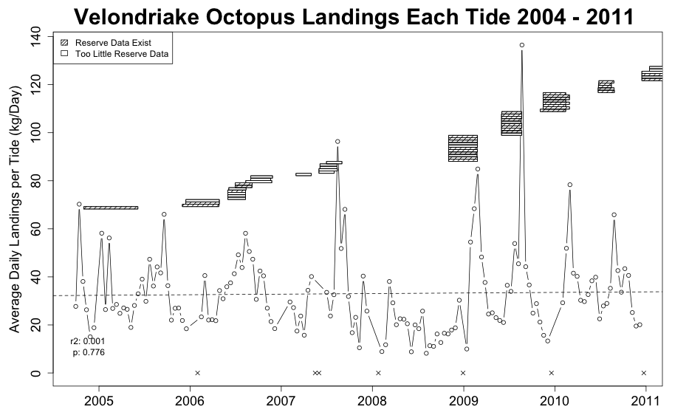
Current Data Set
258,108 Individual Octopus
320 Mapped Fishing Sites
Across 17 Villages
2004 – 2011
69 Closures in Velondriake to date
Enough data in 37 of 69
Notes:
To answer this question, we analyze a huge dataset of octopus landings collected between 2004 and 2011. Blue Ventures has posted data collectors in 17 villages who collect data every day when octopus fishing occurs.
Of the 69 village closures that occurred in this period, we have enough data to examine 37.

Slide 8
Landings Over Time
Notes:
The first thing we see is that average daily landings have remained steady throughout the period.
On the y axis, we have average daily landings per tide. What you see are peaks that occur after closures, represented by the boxes [point to peaks in 2007, 2009, 2010]

Slide 9
Do village octopus closures increase catch?
Do the costs of the closures pay-off economically?
Notes:
So, do these closures increase octopus catch?

Slide 10
Do Octopus Closures Increase Catch?
Before, After, Control, Impact Framework
37 Closure Sites
37 Control Sites
Notes:
To answer this question, we use a BACI framework. We match 37 closure sites with 37 control sites. Control sites were selected based on a number of criteria, including proximity to closure site, similarity in fishing pressure, etc.

Slide 11
Do Octopus Closures Increase Catch?
Before, After, Control, Impact Framework
6 Weeks Before
6 Weeks After
Closure
(2-7 Months)
37 Closure Sites
37 Closure Sites
37 Control Sites
37 Control Sites
No Closure
Notes:
We examine landings in the periods 6 weeks before and 6 weeks after a closure event.

Slide 12
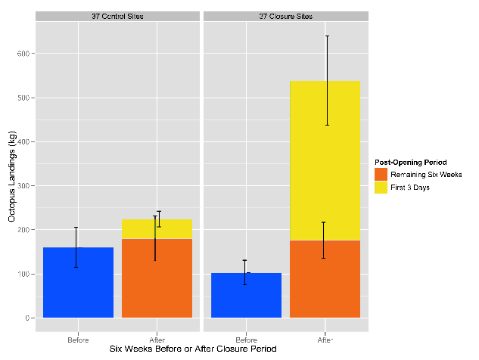
Notes:
We find significant increase in landings in closure sites. I’m going to show you a number of figures like this, so let me walk you through it. On the y axis, octopus landings in kg. The first two boxes are the control sites, the right hand boxes are the closure sites. The blue boxes are the landings for the 6 week period before a site closes. The orange plus yellow are the landings in the 6 week period after the closed site reopens, where the yellow are the landings in the first 3 days and the orange are the landings for the remaining six weeks.

Slide 13
Closure Sites:
+423% ***
Control Sites:
+40% (NS)
Notes:
As you can see, the landings in the closure sites is far higher, with most of the catch being landed in the 1st 3 days.

Slide 14
Landings
+ 5 times
(kg)
Notes:
So, when answering the question: do village octopus closures increase catch, we can definitively say that yes, more octopus is caught in closure sites.
However, this could simply be due to increased effort, so we want to look at a normalized metric.

Slide 15
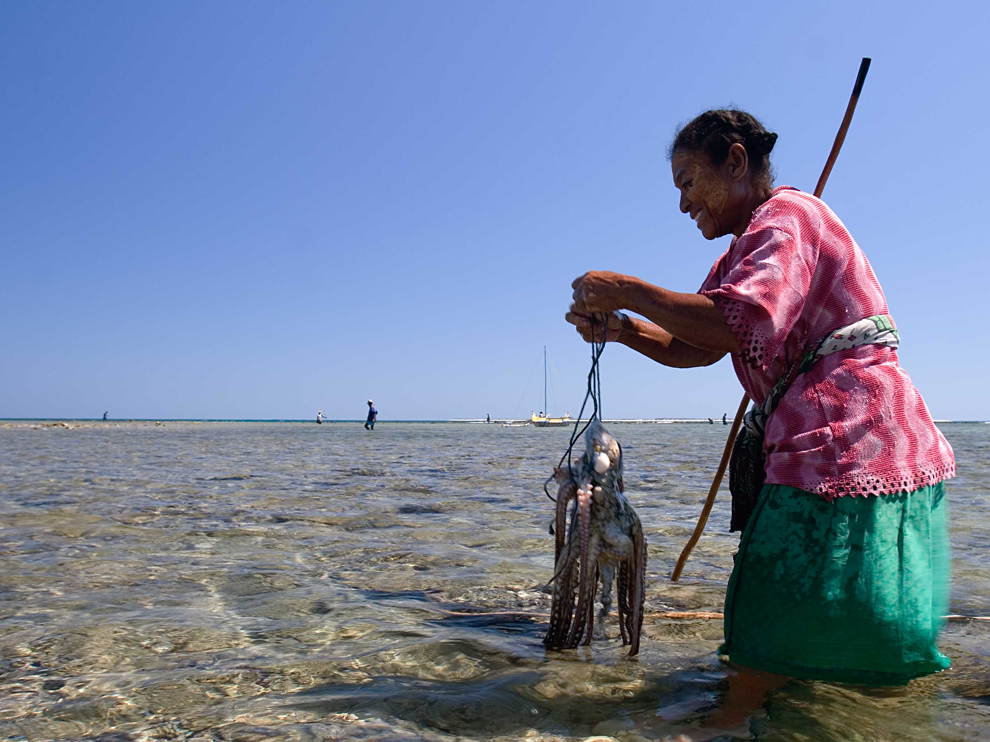
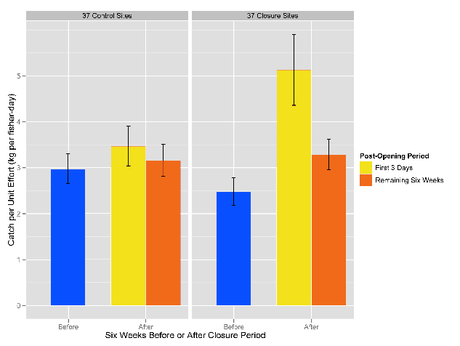
Notes:
Turning to CPUE (on the y axis) we again see increases in the closure sites.

Slide 16
+108%
***
+ 17%
(NS)
+ 6%
(NS)
+33%
*
Notes:
There is a significant increase in CPUE in the closure sites after re-opening, most of which occurs in the 1st 3 days, but the increase remains significant for the entire 6 week period.

Slide 17
+108%
***
Catch per Unit Effort
+ 30 - 100%
(kg/fisher-day)
+33%
*
Notes:
Catch per unit effort goes up 30-100%.

Slide 18
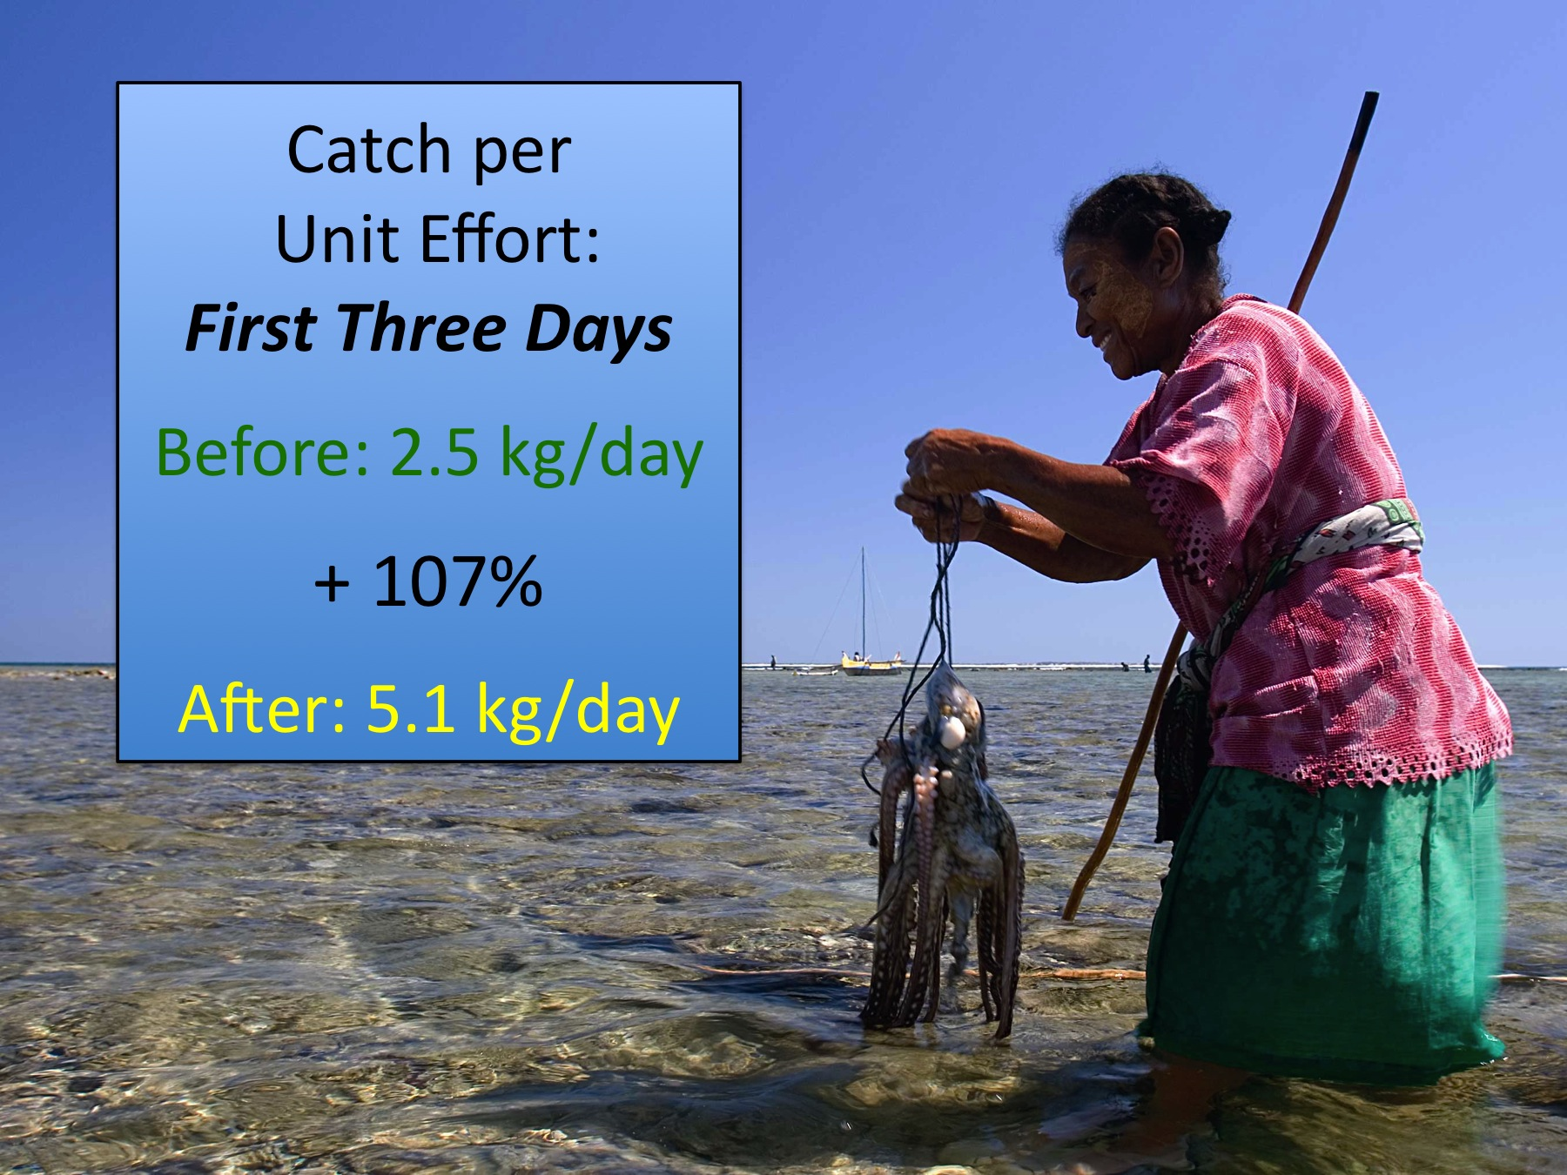
Do Octopus Closures Increase Catch?
Yes.
Notes:
So, we can also conclude that village octopus closures increase both landings and CPUE

Slide 19
Do village octopus closures increase catch?
Do the costs of the closures pay-off economically?
Notes:
This leads us to the next question: [read]

Slide 20
Do the costs of the closures pay-off economically?
Village scale “costs”?
Closure scale “costs”?
Notes:
There are 2 ways to examine costs. From the village scale, and from the individual closure site scale.

Slide 21
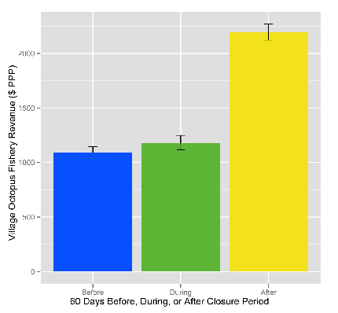
Village Level Octopus Fishery Revenue
Closures: Clear Benefit – No Clear Fishery “Cost”
Total Village-Level Revenue ($ PPP)
+100%
***
+8%
NS
Before
During
After
Notes:
When we examine the village scale, we look at the total village level revenue derived from octopus fishing before, during, and after closures for the villages “sponsoring” the closure events.
We find that revenues do not decline during closure periods, and increase significantly after closures.
In short, the villagers do not give up fishing revenue during the closures (they bear no costs), but derive a clear benefit.

Slide 22

Closure vs. No Closure:
Site–Based Cost Model
Closure
Actual Closure
Data
Notes:
But does each closure site perform equally well?
To look at economic pay-off at the closure site scale, we compare actual to modeled landings. We have actual landings data for a given closed site (in red), and we model the hypothetical landings in a counterfactual scenario as if the site did not close “no closure” (in yellow).

Slide 23

Closure vs. No Closure:
Site–Based Cost Model
Closure
Actual Closure
Data
No Closure
“No Closure”
Modeled From
Fishery Data
Notes:
But does each closure site perform equally well?
To look at economic pay-off at the closure site scale, we compare actual to modeled landings. We have actual landings data for a given closed site (in red), and we model the hypothetical landings in a counterfactual scenario as if the site did not close “no closure” (in yellow).

Slide 24
Closure vs. No Closure:
Site–Based Cost Model
Closure Period
Actual / Simulated
if
>
Closure Profitable
Notes:
If C is larger than NC, then the closure is profitable

Slide 25
Closure vs. No Closure:
Site–Based Cost Model
Closure Period
Actual / Simulated
if
<
Closure Not Profitable
Notes:
If C is larger than NC, then the closure is profitable

Slide 26
Closure vs. No Closure:
Site–Based Cost Model
Closure Period
Actual / Simulated
Net Earnings (NE)
How much money it will make
Internal Rate of Return (IRR)
How quickly it will make it
Notes:
We examine two different notions of profitability, net earnings and IRR. Net earnings tell us how much money the site makes, and the IRR tells us how quickly it will make the money.

Slide 27
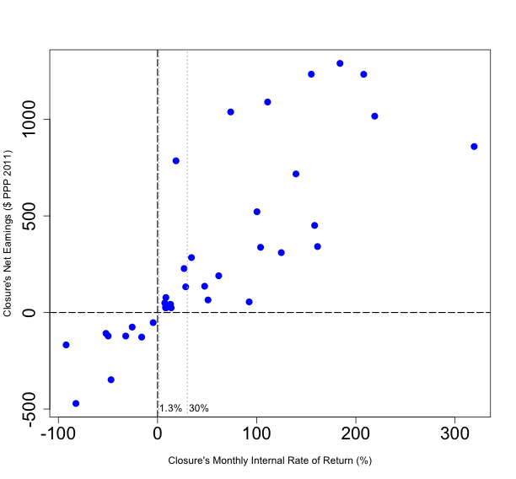
Profitability of 37 Closures
(Median of 1000 Model Runs)
Net Earnings ($ PPP)
Monthly Internal Rate of Return (%)
Notes:
Here’s what we find. On the y axis, we have net earnings in international dollars, on the x axis is monthly IRR. [stres monthly]

Slide 28
Profitability of 37 Closures
(Median of 1000 Model Runs)
Net Earnings ($ PPP)
Profitable: 28/37
Mean NE: $450(PPP)
Mean Monthly IRR: 88%
Monthly Internal Rate of Return (%)
Not Profitable: 9/37
Notes:
28 of the 37 closures are profitable, with a mean NE of $450, and a mean monthly IRR of 88%

Slide 29
Profitability of 37 Closures
(Median of 1000 Model Runs)
Net Earnings ($ PPP)
Monthly Internal Rate of Return (%)
Notes:
You’ll note here 2 faint vertical lines at 1.3% and 30%.
These represent discount rates – the discount rate basically represents an individual’s preference to have something now instead of at some point in the future.
1.3% monthly is a standard social discount rate used in international development, and 30% monthly is a local discount rate that an anthropologist found through an experiment with the local fishers. Subsistence fishers tend to have high discount rates, but this estimate likely represents the upper bound.
Basically, if an investment does not return a payoff in the time period represented by the fishers’ discount rate, they will not judge it to be a good investment.

Slide 30
Profitability of 37 Closures
(Median of 1000 Model Runs)
Net Earnings ($ PPP)
Profitable at 30% Monthly Discount Rate: 20/37
Monthly Internal Rate of Return (%)
Not Profitable: 9/37
Notes:
What we see here, is that 20 of the 37 closures exceed the very high local discount rate of 30% monthly. These will be judged to be good investments by the fishers.
Let’s turn our attention to the closures that were NOT profitable.

Slide 31
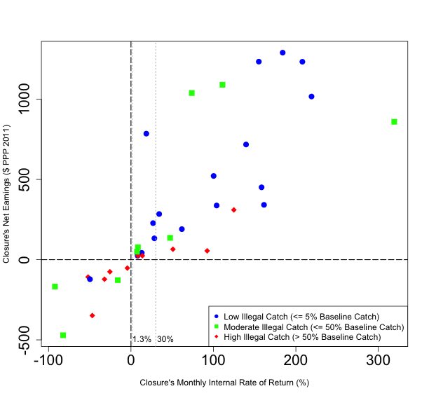
Profitability: Effect of Illegal Catch
(Median of 1000 Model Runs)
Net Earnings ($ PPP)
Monthly Internal Rate of Return (%)
Notes:
We code the sites according to their rate of illegal catch (= reported landing from the closed sites during a closure)
(low = less than 5% of baseline catch; moderate = ~50% of baseline, and high = >50% of baseline)

Slide 32
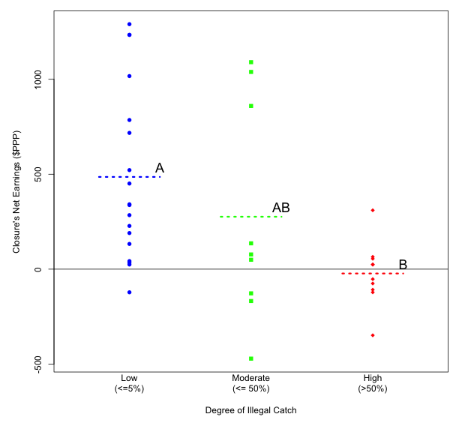
Effect of Illegal Catch on Net Earnings
(Median of 1000 Model Runs)
Net Earnings ($ PPP)
Illegal Catch as Percentage of Baseline Catch (%)
Notes:
We see that the net earnings of sites where illegal catch was low was significantly higher than both the moderate and high levels. In short, if there was illegal fishing, the profitability suffers.

Slide 33
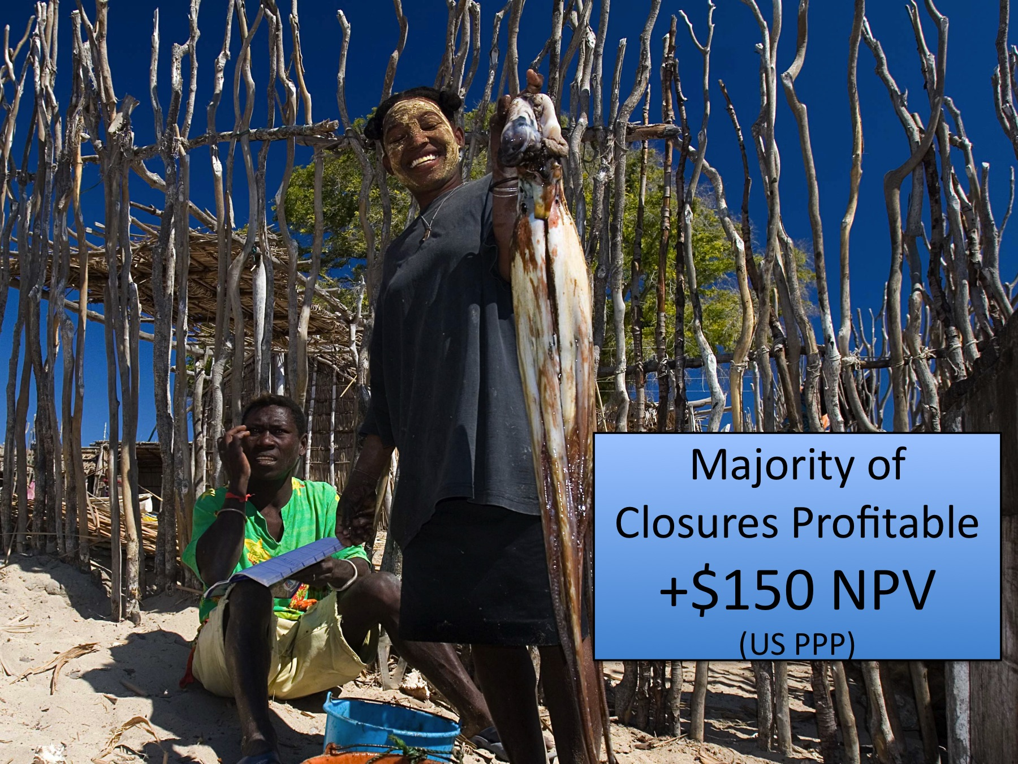
Do the costs of the closures pay off economically?
Yes.
Majority of Closures Profitable: 28/37
NE: + $450 (PPP)
Notes:
So, we can answer Yes to the question “Do the costs of the closures pay off economically?”

Slide 34
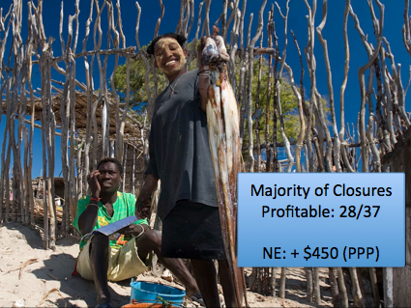
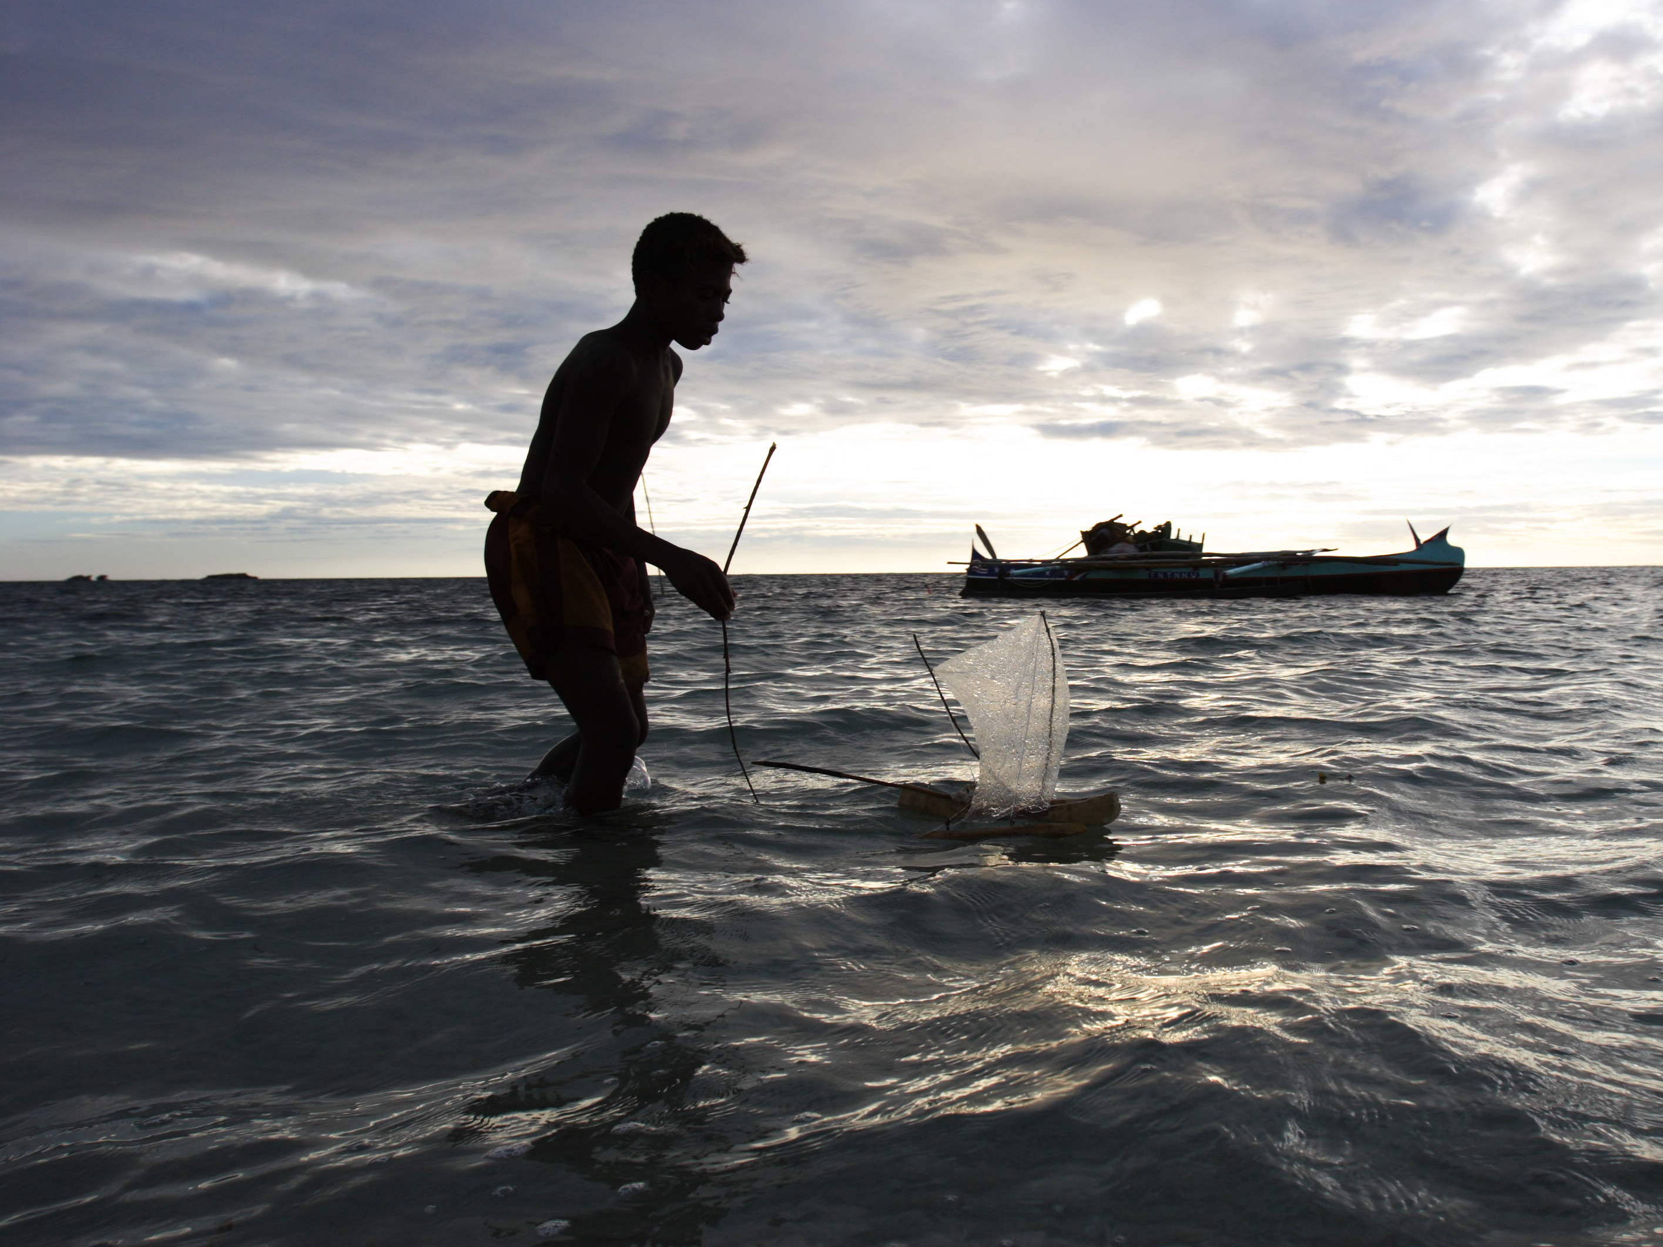
Fisheries Benefits
Economic Benefits
Social Benefits
Increased understanding of and support for community management
Notes:
We’ve talked about the fisheries and economic benefits of the closures, but another major outcome is the social benefits, where people are shifting from a fatalistic to a deterministic view of their environment.

Slide 35








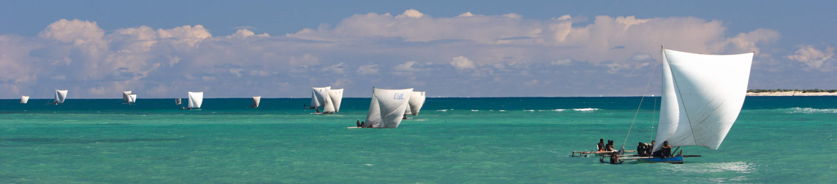

Study brought to you by:
250,000+ measured octopus
3,000+ cooperative fishers
Hundreds of households
Dozens of patient nahoda, informants
1,000+ hours of data collection, entry, QC
Immeasurable effort of BV staff
Questions?: Email: koleson@hawaii.edu
Or: tom.andrew.oliver@gmail.com
Photos courtesy of Garth Cripps
Notes:
We want to thank the many fishers, households, data collection staff, quality control SWAT team, and our funders and collaborators.

Slide 36
Modeling Costs & Benefits:
The Closure Site–Based Economic Model
Closure Period
Actual Closure
Data
“No Closure”
Modeled From
Fishery Data
Notes:
But does each closure site perform equally well?
To look at economic pay-off at the closure site scale, we compare actual to modeled landings. We have actual landings data for a given closed site (in red), and we model the hypothetical landings in a counterfactual scenario as if the site did not close “no closure” (in yellow).

Slide 37
Modeling Costs & Benefits:
The Closure Site–Based Economic Model
Closure Period
Actual Closure
Data
“No Closure”
Modeled From
Fishery Data
Notes:
We want to compare the “actual” to the “no closure” landings.
I don’t have time to go into the nitty gritty of the model, but it is a stochastic model that calculates catch by drawing from the distributions of actual CPUE and number of fishers on any given day.

Slide 38
Modeling Costs & Benefits:
The Closure Site–Based Economic Model
Closure Period
Actual / Simulated
Actual Closure Catch
C
Notes:
To do so, we compare the actual closure catch, C, in red…

Slide 39
Modeling Costs & Benefits:
The Closure Site–Based Economic Model
Closure Period
Actual / Simulated
Modeled
No Closure “Catch”
NC
Notes:
…To the modeled no closure hypothetical catch, NC in yellow

